Slide 1
MIKE 11
Control Structures

Slide 2
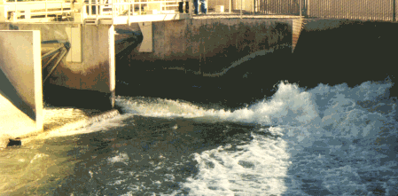
CONTROL STRUCTURES
Complex Operations and Regulation

Slide 3
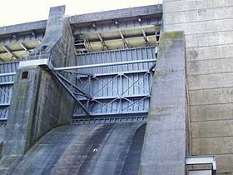
CONTROL STRUCTURES
Control structure used whenever the flow through a structure is to be regulated by the operation of a movable gate (sluice gate, underflow gate, radial gate) or the flow is controlled directly as in the case of pump or turbine
Setting up a control structure in MIKE 11 is defining a CONTROL STRATEGY
The control strategy is the sequence of commands or rules that determine the way a structure can be operated in MIKE 11
A structure can have any number of strategies defined by a sequence of conditions that must be evaluated as TRUE or FALSE

Slide 4
CONTROL STRUCTURES
Defined in the Network File
How? Network File -> View -> Tabular View -> Structures Page
Control Structure Types:
Underflow Gate (Sluice Gates)
Overflow Gates (Inflatable Dams and Movable Weirs)
Radial Gates (Dam Spillways)
Discharge Control (Pumps, Turbines)

Slide 5
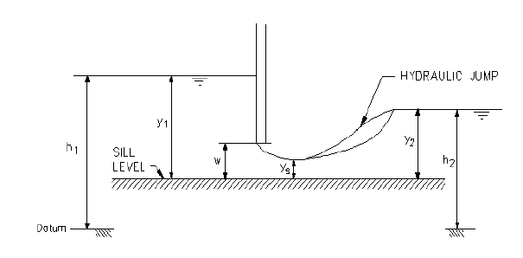
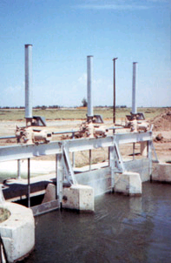
CONTROL STRUCTURES
Underflow Gates (Sluice)

Slide 6
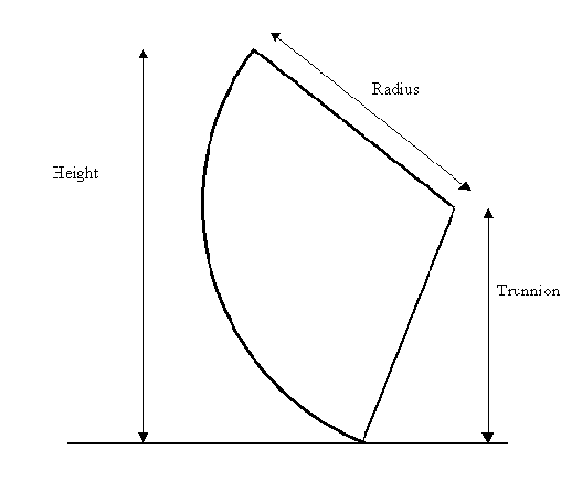
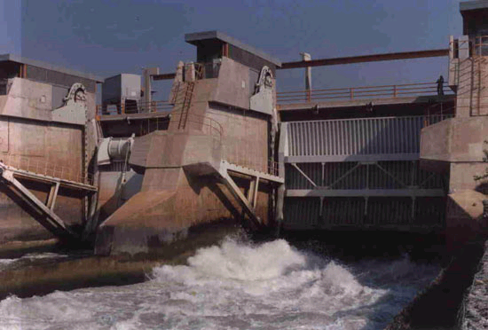
CONTROL STRUCTURES
Radial Gates (Spillways)

Slide 7
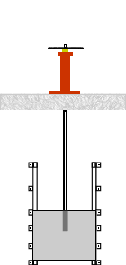
CONTROL STRUCTURES
Implemented with a Control Strategy
A Control Strategy consists of:
A Control Definition
A Control Rule
Logical statements that define the conditions for implementing the strategy
Logical statements that define the conditions for implementing the strategy
The settings (or Target Point ) for the structure as a function of the Control Point
The settings (or Target Point ) for the structure as a function of the Control Point

Slide 8
CONTROL STRUCTURES
Logical Decision Tree – Control Strategy
Start (for each time step)
Set Gate
Priority 1 Logicals
True
Strategy 1
False
Priority 2 Logicals
True
Strategy 2
False
Always True
Priority N Logicals
Strategy N

Slide 9
CONTROL STRUCTURES
Control and Target Points
A Control Point is the Variable used to Determine the Target Function:
Flood levels
Reservoir Inflows
Time of year
A Target Point is the Variable
Being Set:
Gate level
Reservoir level
Discharge
Variable Types:
Water level (H)
Water level difference (dH)
Discharge (Q)
Discharge difference (dQ)
Sum of discharges
Velocities (V)
Volumes
Concentrations
Calendar
Time-series

Slide 10
CONTROL STRUCTURES
Calculation Modes
Calculation Modes for Control Structures:
Direct Gate Operation (Tabulated, Closed, Open, Set Equal to, etc)
PID Control (Proportional Integral Derivative)
Momentum Equation
Iterative Solution
Water Level
Gate Level

Slide 11
CONTROL STRUCTURES
Control Structure Page in Network File
Control Definitions Tab
Attributes Tab
Overview of all Control Structures in the Model

Slide 12
CONTROL STRUCTURES
Attributes Tab (Overflow, Underflow and Discharge)
Standard Head Losses Apply to All

Slide 13
CONTROL STRUCTURES
Attributes Tab (Radial Gate and Sluice/Formula)

Slide 14
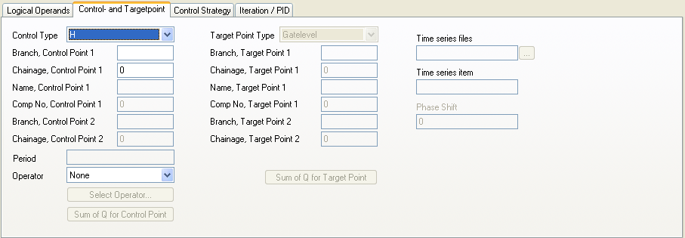
CONTROL STRUCTURES
Control Definitions Tab
Calculation Modes

Slide 15
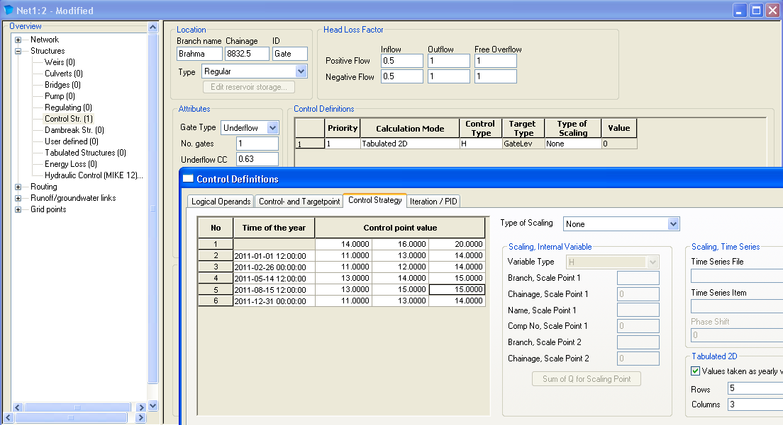
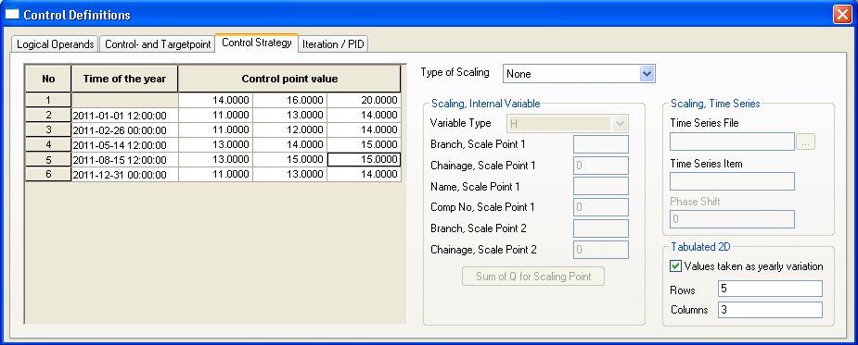
CONTROL STRUCTURES
Time dependent control strategies
New option in release 2012
Tabulated control strategies as function of time
Example: Rating curve value depending on day of year

Slide 16
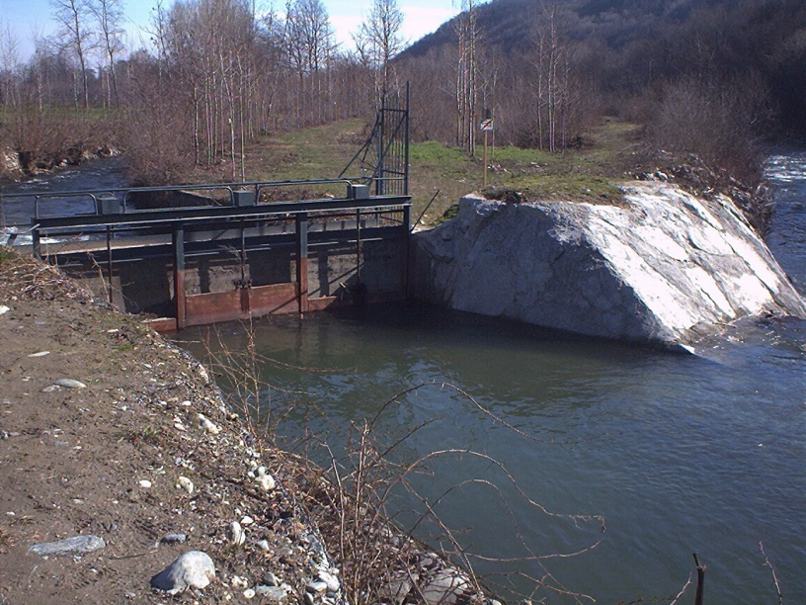
CONTROL STRUCTURES
Control Structures Notes
Allows for defining highly advanced and complex control and regulation strategies (Reservoir outlet optimization, Irrigation, Flood control etc.)
For stability - as for all other structures: Ensure that structure geometry (width and sill level) are always smaller than up- and downstream sections
Geometry limitation: Structures of constant width

